Slide 1
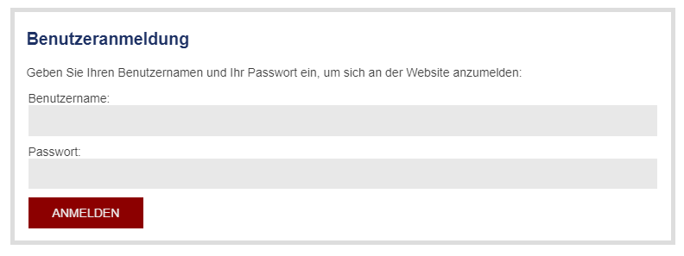
Cisco Download Guide
To download Cisco click here or follow the link below:
https://www.whz.de/zki/netzdienste/vpn-einwahl/cisco-download/#c4705
2. For registration you need your WHZ username and password. Please enter these in the marked fields:
<─ username
<─ password
<─ log in

Slide 2
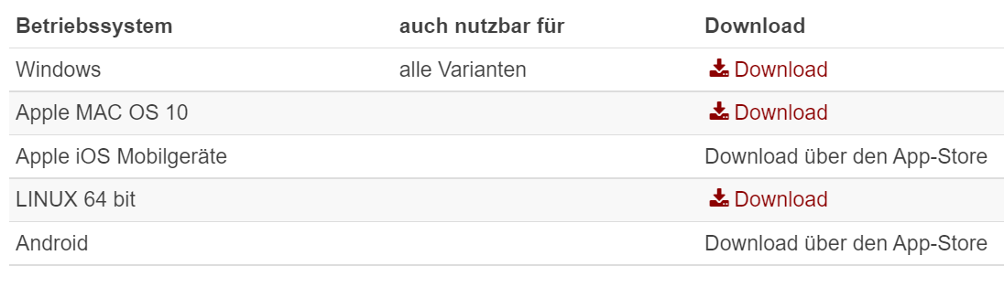
Cisco Download Guide
3. After successful registration, you will be forwarded directly to the Cisco download. Please download Cisco depending on the operating system of your PC.
<─ operating system
If you want to download Cisco on your mobile device, please use App-Store.

Slide 3
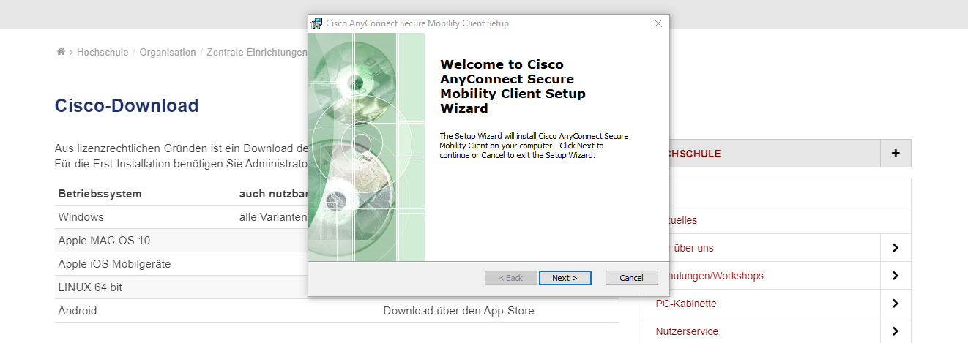
Cisco Download Guide
Open the downloaded file
In the pop-up window press the “Next" button

Slide 4
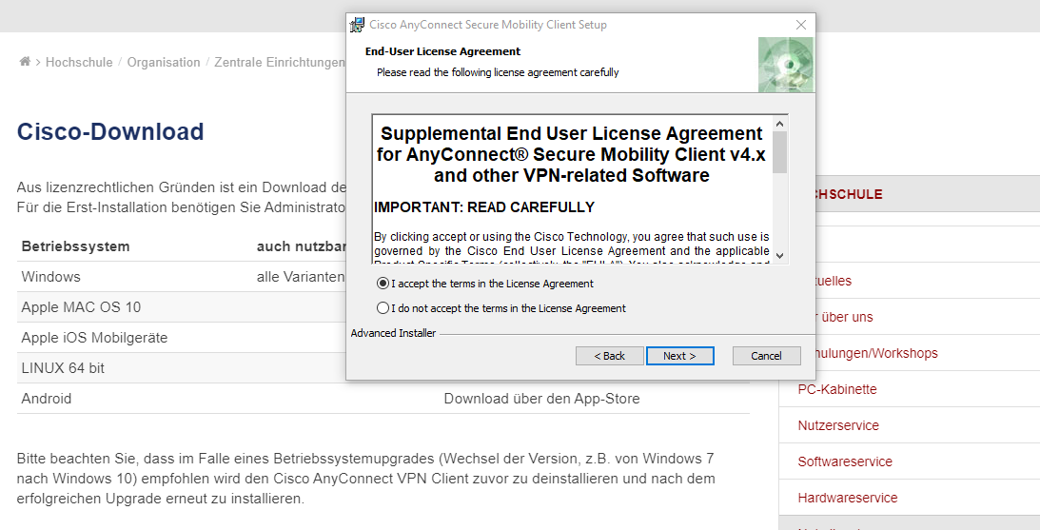
Cisco Download Guide
6. Select the option "I accept the terms in the License Agreement" and click "Next“

Slide 5
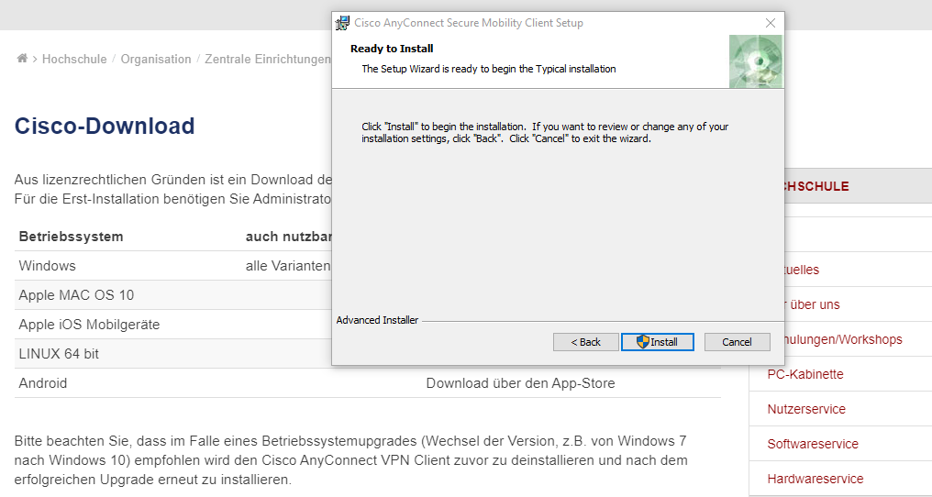
Cisco Download Guide
7. Click “Install“ and wait until the installation is complete

Slide 6
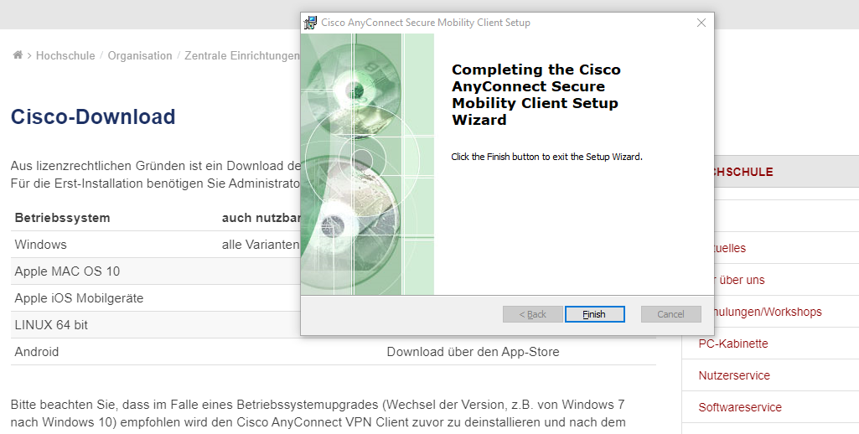
Cisco Download Guide
8. Click the button “Finish“.

Slide 7
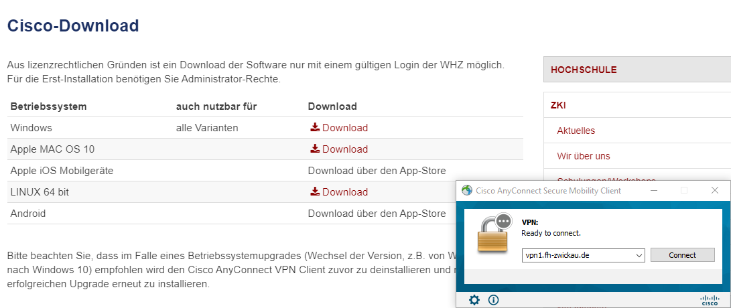
Cisco Download Guide
9. Retrieve Cisco on your PC and click “Connect”

Slide 8
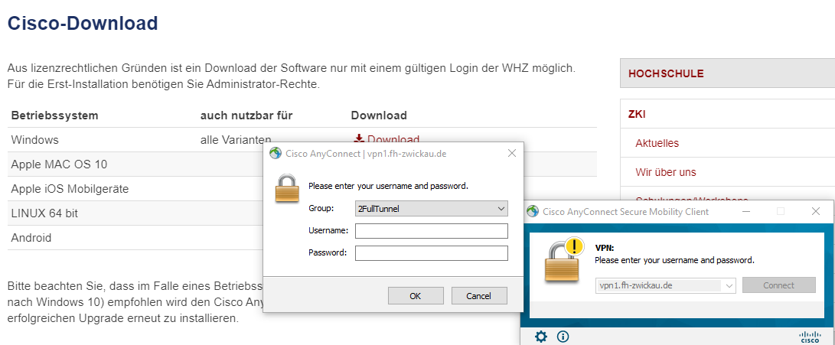
Cisco Download Guide
10. Select "2FullTunnel" in the pop-up window and fill in your username and password

Slide 9
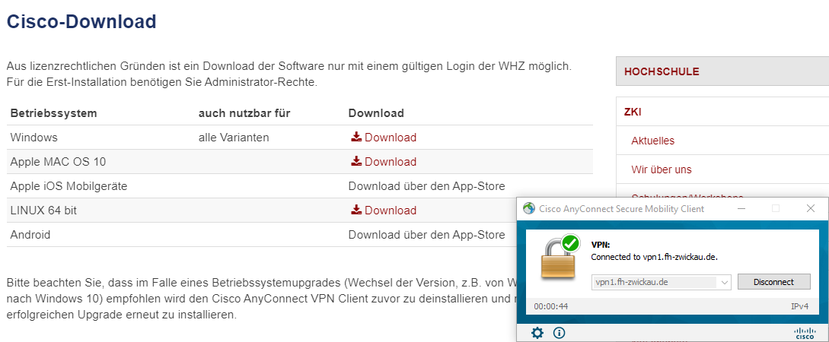
Cisco Download Guide
11. You are successfully connected. To disconnect click "disconnect".

Slide 10
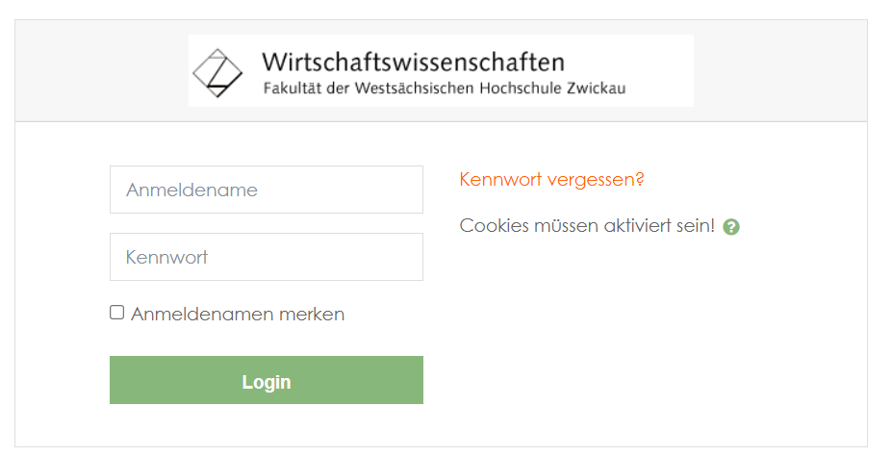
Moodle Guide
To login in moodle click the link below:
https://moodle.whz.de/moodle/login/index.php
2. For registration you need your WHZ username and password. Please enter these in the marked fields:
<─ username
<─ password

Slide 11
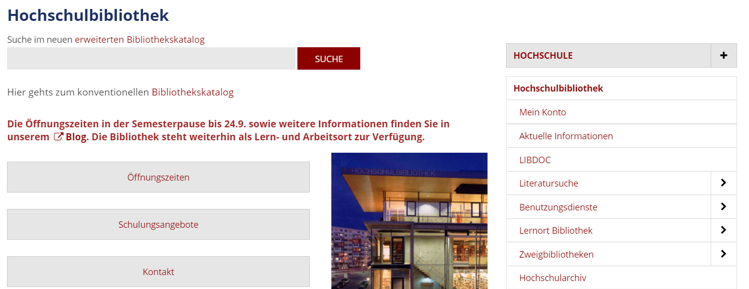
Library Guide
Make sure you are connected to Cisco to be able to download ebooks.
To login in the WHZ library click the link below:
    https://www.whz.de/bib/
3. Enter in the search which book you are looking for and press the button
<─ search

Slide 12
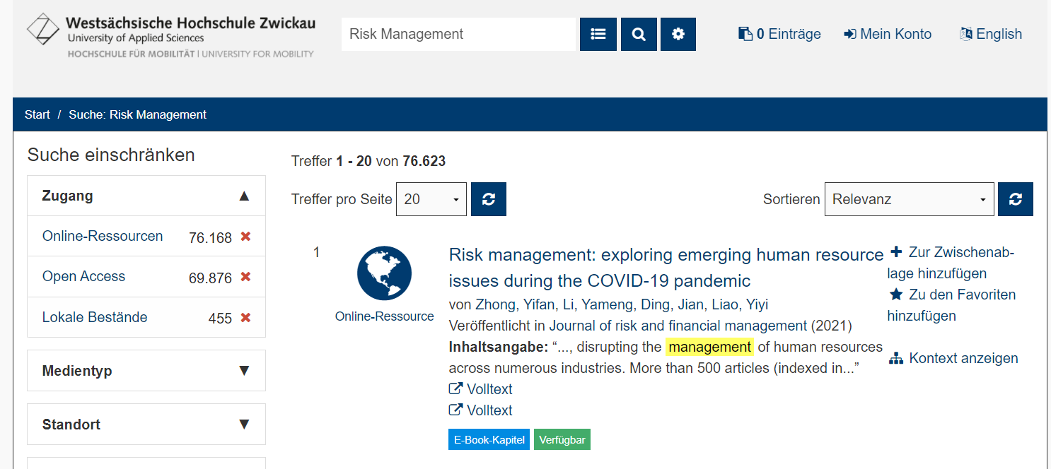
Library Guide
4. If there is a blue box with Ebook visible below, click on the title to download it.
(You can filter directly for online resources)

Slide 13
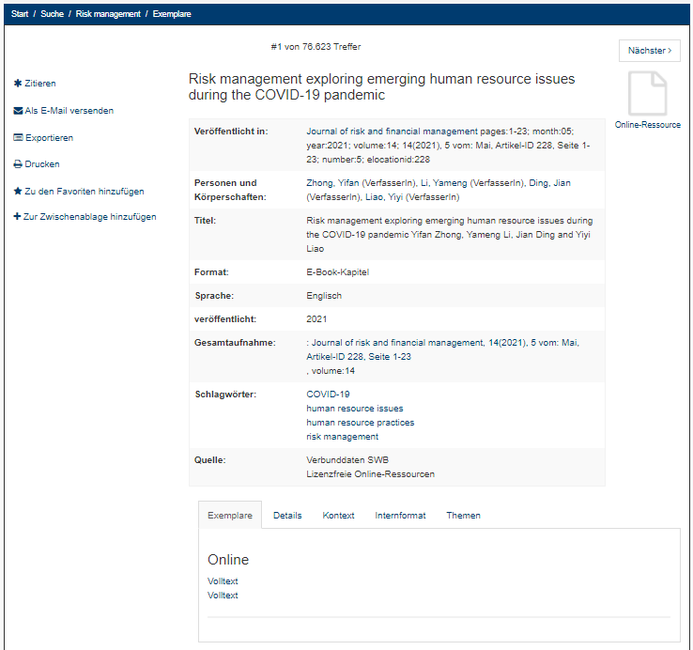
Library Guide
5. Click below at online on full text
<─ full text

Slide 14
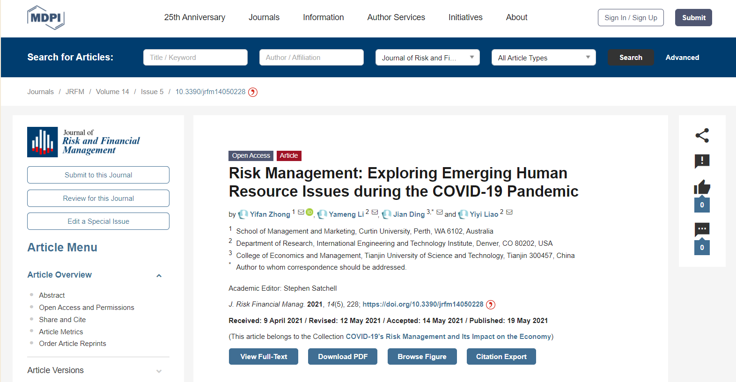
Library Guide
6. Click Download PDF on the publisher's page to download the ebook.

